Slide 1
Object oriented analysis & design
CS3C015

Slide 2
UNIT- 1
Structure of Complex Systems, Object Oriented Development Methods, Characteristics of Objects, Fundamental Concepts of Object orientation, UML- Overview, RUP and its Phases

Slide 3
prerequisites
Software Engineering(SDLC)
Object Oriented Programming(OOP)

Slide 4
Object-oriented analysis and design
Object-oriented analysis and design (OOAD) is a popular technical
approach for
analyzing,
designing an application, system, or business
by applying the object oriented paradigm and
visual modeling throughout the development life cycles for better communication
and product quality.
Object-oriented programming (OOP) is a method
based on the concept of “objects",
which are data structures that contain data,
in the form of fields,
often known as attributes;
and code, in the form of procedures,
often known as methods.

Slide 5
Continued…
What is OOAD?- Object-oriented analysis and design (OOAD) is a software engineering approach that models a system as a group of interacting objects .
Analysis — understanding, finding and describing concepts in the problem domain.
Design — understanding and defining software solution/objects that represent the analysis concepts and will eventually be implemented in code.
OOAD - A software development approach that emphasizes a logical solution based on objects.

Slide 6
Object oriented analysis & design
Object-oriented analysis and design (OOAD) is a technical approach used in the analysis and design of an application or system through the application of the object-oriented paradigm and concepts including visual modeling.

Slide 7
Object oriented analysis & design
Is a way of thinking of problems using models organized around real world concepts.

Slide 8
Object oriented analysis & design
Object-oriented analysis and design (OOAD) is a software engineering approach that models a system as a group of interacting objects and by defining a rules of objects.

Slide 9
Software engineering
SOFTWARE
+
ENGIEERING

Slide 10
software
Software is more than just a program code. A program is an executable code, which serves some computational purpose.
Software is considered to be collection of executable programming code, associated libraries and documentations.
Software, when made for a specific requirement is called software product.

Slide 11
Engineering on the other hand, is all about developing products, using well-defined, scientific principles and methods.

Slide 12
Software engineering is an engineering branch associated with development of software product using well-defined scientific principles, methods and procedures.
The outcome of software engineering is an efficient and reliable software product.

Slide 13
Software process model(sdlc)
Software process model is an abstraction of the software development process. The models specify the stages and order of a process. So, think of this as a representation of the order of activities of the process and the sequence in which they are performed.
Goal:- The goal of a software process model is to provide guidance for controlling and coordinating the tasks to achieve the end product and objectives as effectively as possible.

Slide 14
Software process model(sdlc)
Need:-
software product can be developed systematically.
Helps common understanding of activities.
Helps to identify inconsistencies, redundancies and omissions.

Slide 15
Generic Process Model
Process:- A process is a series of steps involving activities, constraints and resources that produce an intended output of some kind.
Software Process:- is the related set of activities and processes that are involved in developing and evolving a software system
Any software process must include the following four activities:
Software specification.
Software design and implementation.
Software verification and validation.
Software evolution.

Slide 16
Communication
Phases of software model
Planning
Modeling
Construction
Deployment

Slide 17


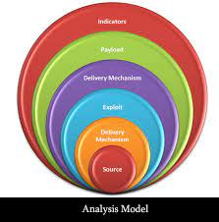


1. Communication: The software development starts with the communication between customer and developer. 2. Planning: It consists of complete estimation, scheduling for project development and tracking. 3. Modeling: Modeling consists of complete requirement analysis and the design of the project like algorithm, flowchart etc.
4. Construction: Construction consists of code generation and the testing part..
5. Deployment : Deployment step consists of delivering the product to the customer and take feedback from them.

Slide 18
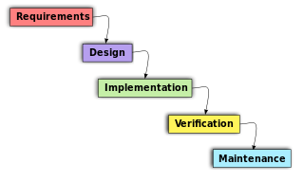
OOAD In The SDLC
The software life cycle is typically divided up into stages going from abstract descriptions of the problem to designs then to code and testing and finally to deployment.

Slide 19
Object-Oriented Analysis And Design (OOAD)
In analysis developers work with users and domain experts to define what the system is supposed to do. Implementation details are supposed to be mostly or totally ignored at this phase.
The goal of the analysis phase is to create a model of the system regardless of constraints such as appropriate technology. This is typically done via use cases and abstract definition of the most important objects using conceptual model.
The design phase refines the analysis model and applies the needed technology and other implementation constrains.
It focuses on describing the objects, their attributes, behavior, and interactions. The design model should have all the details required so that programmers can implement the design in code.
They’re best conducted in an iterative and incremental software methodologies. So, the activities of OOAD and the developed models aren’t done once, we will revisit and refine these steps continually.

Slide 20
Object-Oriented Analysis
In the object-oriented analysis, we …
Elicit requirements: Define what does the software need to do, and what’s the problem the software trying to solve.
Specify requirements: Describe the requirements, usually, using use cases (and scenarios) or user stories.
Conceptual model: Identify the important objects, refine them, and define their relationships and behavior and draw them in a simple diagram.

Slide 21
Object-Oriented Design
The analysis phase identifies the objects, their relationship, and behavior using the conceptual model (an abstract definition for the objects).
While in design phase, we describe these objects (by creating class diagram from conceptual diagram — usually mapping conceptual model to class diagram), their attributes, behavior, and interactions.
The input for object-oriented design is provided by the output of object-oriented analysis. But, analysis and design may occur in parallel, and the results of one activity can be used by the other.

Slide 22
In the object-oriented design, we …
Describe the classes and their relationships using class diagram.
Describe the interaction between the objects using sequence diagram.
Apply software design principles and design patterns.
A class diagram gives a visual representation of the classes you need. And here is where you get to be really specific about object-oriented principles like inheritance and polymorphism.
Describing the interactions between those objects lets you better understand the responsibilities of the different objects, the behaviors they need to have.

Slide 23

system
A group of things or parts that work together.
A system is a group of interacting or interrelated elements that act according to a set of rules to form a unified whole.
A system is a collection of elements or components that are organized for a common purpose.

Slide 24
Software systems
Software systems are not any different from other systems with respect to these characteristics. Thus, they are also embedded within some operational environment, and perform operations which are clearly defined and distinguished from the operations of other systems in this environment
Example. Library management system.
College information Management System
E-Learning Portal

Slide 25
complexity
Complexity depends on the number of the components embedded in them as well as the relationships and the interactions between these components which carry;
• Impossible for humans to comprehend fully
• Difficult to document and test
• Potentially inconsistent or incomplete
• Subject to change
• No fundamental laws to explain phenomena and approaches

Slide 26
Complexity
The larger the number of components and relationships between them, higher will be the complexity of the overall system.
Grady Booch
The function of good software is to make the complex appear to be simple.
Simple-
Largely forgettable applications
Very limited purpose
Afford to throw them away

Slide 27
The Structure of Complex systems:
Examples of Complex Systems:
The Structure of a Personal Computer
The Structure of Plants and Animals
The Structure of Matter
The Structure of Social Institutions

Slide 28
Personal Computer

Slide 29
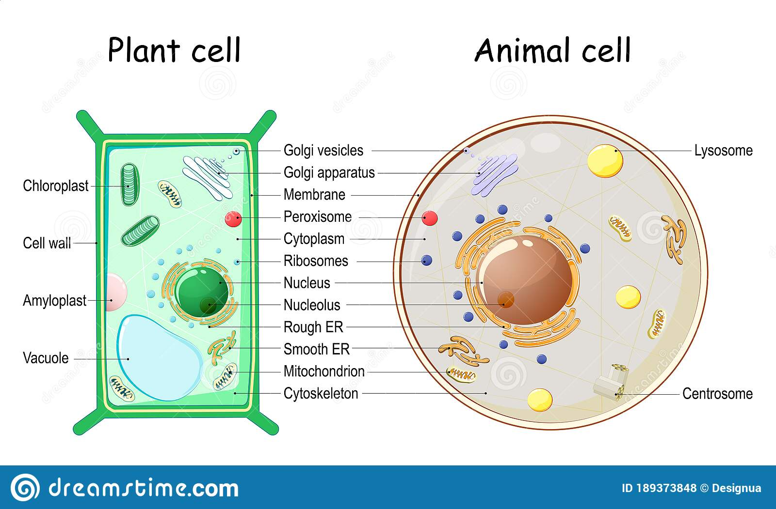
The Structure of Plants and Animals

Slide 30
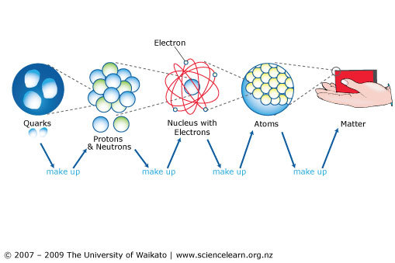
The Structure of matter :

Slide 31
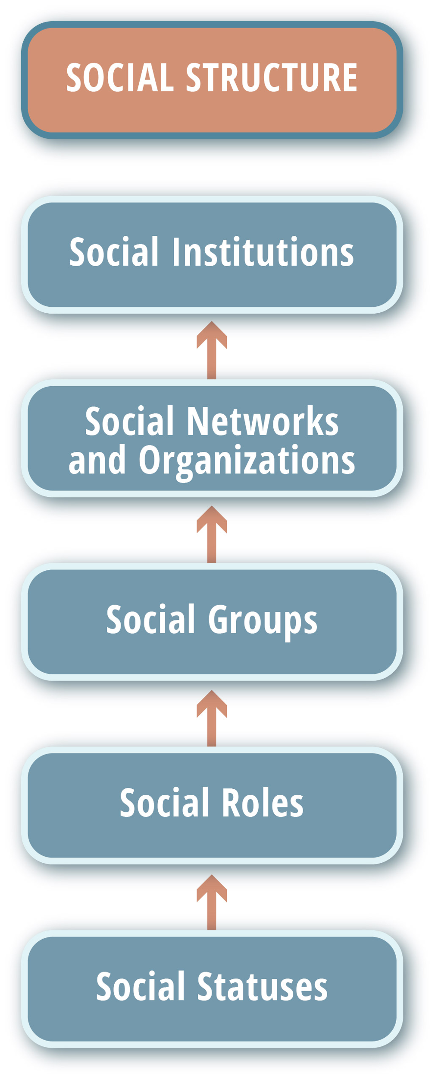
The Structure of social institutions:

Slide 32
Properties' of systems
Simple Systems
Complex Systems

Slide 33
Why Software Is Inherently Complex
The complexity of problem domain
The difficulty of managing the development process
The flexibility possible through software
The problem of characterizing the behavior of systems.

Slide 34
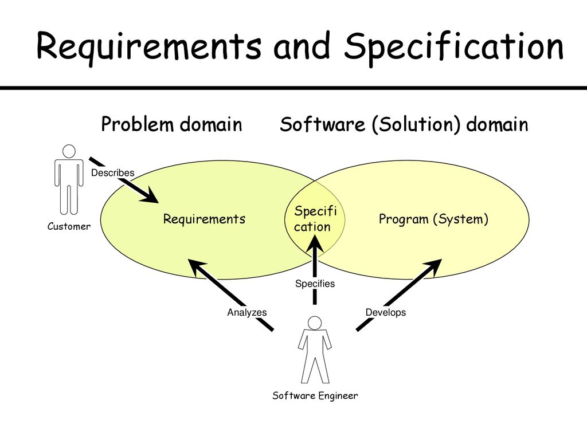
Why Software Is Inherently Complex
The complexity of problem domain
Complex Requirement
Decay of System
Example:
Multi engine aircraft
Cellular Phone

Slide 35

Why Software Is Inherently Complex
2. The difficulty of managing the development process
Management Problems
Need of Simplicity

Slide 36

Why Software Is Inherently Complex
3. The flexibility possible through software.
Developers develop system components themselves rather than purchasing them from somewhere

Slide 37
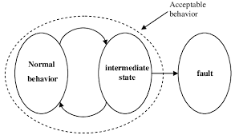
Why Software Is Inherently Complex
4. The problem of characterizing the behavior of systems.
Numerous possible states
Difficult to express all states

Slide 38
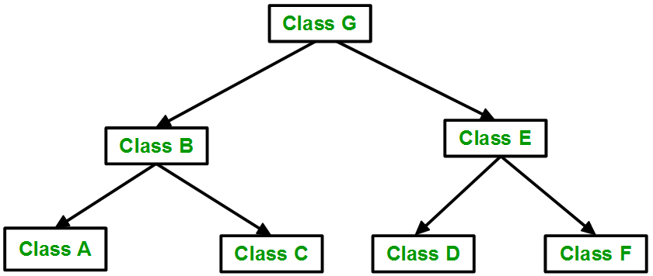
Attributes of Complex system
Hierarchical and interacting subsystems.
A complex system is composed of interrelated subsystems that have in turn their own subsystems and so on until some lowest level of elementary components is reached.

Slide 39
Attributes of Complex system
2. Arbitrary determination of primitive components. The choice of what components in a system are primitive is relatively arbitrary and is largely up to the discretion of the observer of the system.

Slide 40
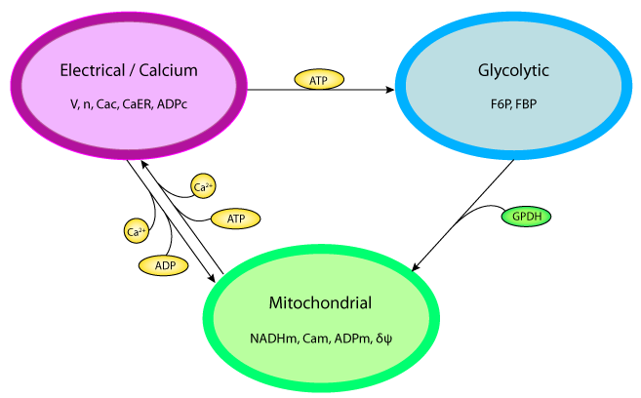
Attributes of Complex system
3. Stronger intra-component than inter components: Intra component linkages are generally stronger than inter component linkages. This fact has the effect of separating the high-frequency dynamics of the components—involving the internal structure of the components.

Slide 41
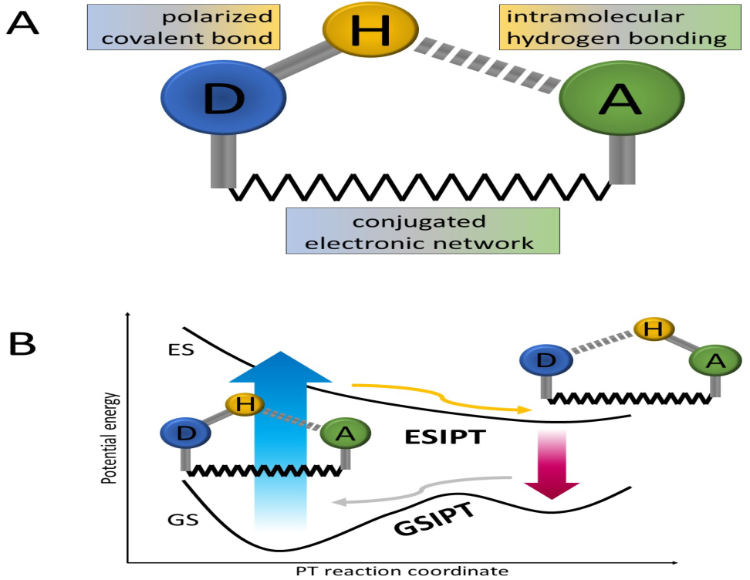
Attributes of Complex system
4. Combine and arrange common rearranging subsystems
Hierarchic systems are usually composed of only a few different kinds of subsystems in various combinations and arrangements.

Slide 42
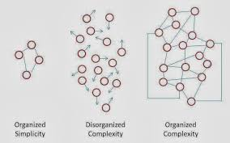
Attributes of Complex system
5. Evolution from simple to complex system.
A complex system that works is invariably found to have evolved from a simple system that worked.... A complex system designed from scratch never works and cannot be patched up to make it work., beginning with a working simple system.

Slide 43
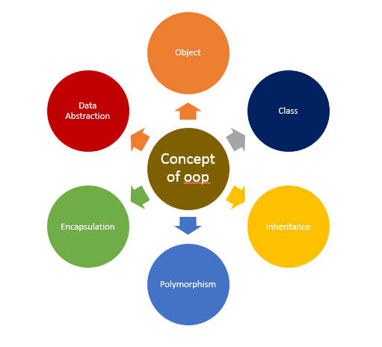
Basic concepts of oops

Slide 44
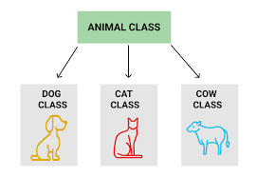
Basic concepts of oop
1. Class- Combination of data & function.
Eg- Fruit, Animal and Employee etc.

Slide 45
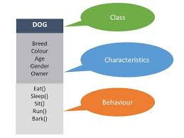
Basic concepts of oop
2. . Object:- Run time entity of class.
Eg- Mango, Dog and Manager etc

Slide 46
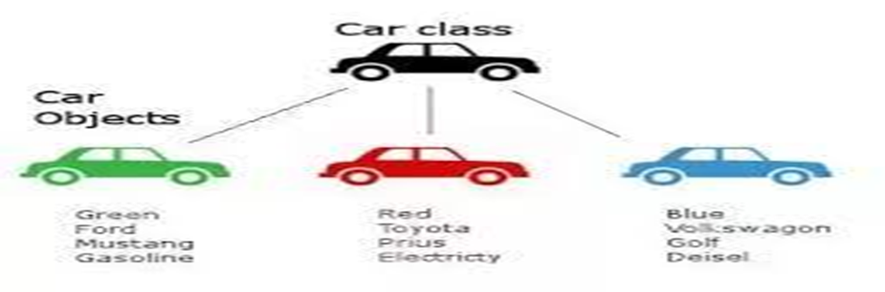
Class and object

Slide 47
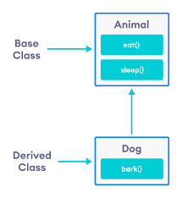
Basic concepts of oop
3. Inheritance :- Acquires the properties of parent.
Eg- Passing of physical or mental characteristics from one generation to another.

Slide 48
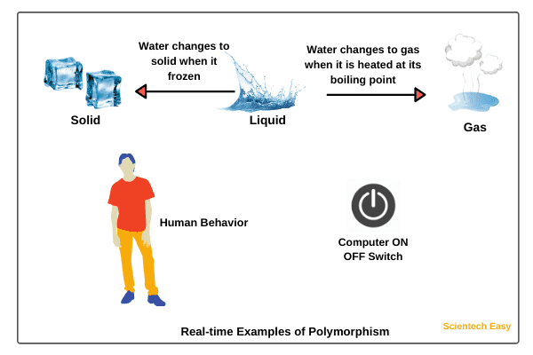
Basic concepts of oop
4. Polymorphism: one name many form.
Eg- addition (two,three or five values)

Slide 49
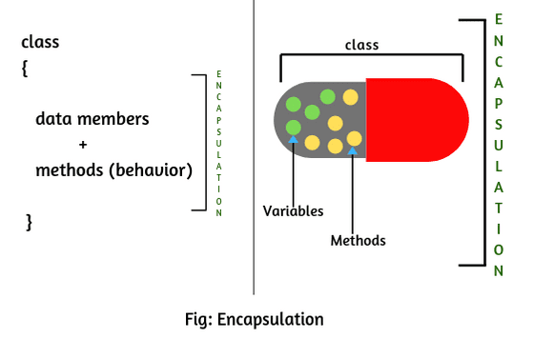
Basic concepts of oop
5. Data Encapsulation: Putting together.
Eg- company, college and Bus etc.

Slide 50

Basic concepts of oop
6. Data Abstraction: Process of hiding details from user.
Eg- sending SMS.

Slide 51
ORTHOGONAL VIEWS OF THE SOFTWARE
Two Approaches,
Traditional Approach
Objected-Oriented Approach
TRADITIONAL APPROACH
Collection of programs or functions.
A system that is designed for performing certain actions.
Algorithms + Data Structures = Programs.
Software Development Models (Waterfall, Spiral, Incremental, etc..)

Slide 52
Continued…
OBJECT ORIENTED APPROACH(METHODS)
OO development offers a different model from the traditional software →
based on functions and procedures.
software is a collection of discrete object that encapsulate their data as
well as the functionality.
Each object has attributes (properties/features/data) and method (procedures/OPERATIONS).
software by building self contained modules or objects that can be easily
REPLACED, MODIFIED AND REUSED.
Objects grouped in to classes and object are responsible for itself.

Slide 53
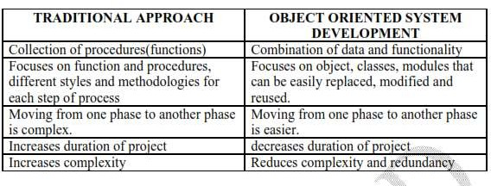
Difference between Traditional and Object Oriented Approach(methods)

Slide 54
OBJECT BASICS
Goals:
The developer should
Define Objects and classes
Describe objects, methods, attributes and how objects respond to messages,
Define Polymorphism, Inheritance, data abstraction, encapsulation, and protocol,
Describe objects relationships,
Describe object persistence,

Slide 55
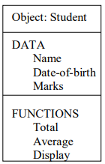
Object definition
Objects are the basic run-time entities in an object-oriented system. They may represent a person, a place, a bank account, a table of data or any item that the program must handle.
Each object contains its own data and its own logic, and they communicate between themselves.

Slide 56
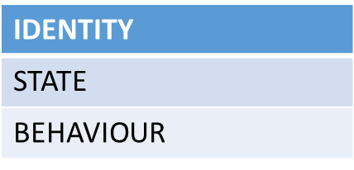
Characteristics of object
An object has identity (each object is a distinct individual).
An object has state (it has various properties, which might change).
An object has behavior/operation (it can do things and can have things done to it).

Slide 57
Operations of object
There are 5 operations
Modifier
Selector
Iterator
Constructor
destructor

Slide 58
Operations of object
1. Modifier :- An Operation that changes the state of an object.

Slide 59
Operations of object
2. Selector :- An Operation that access the state of an object, but doesn’t change the state of an object.

Slide 60
Operations of object
3. Iterator :- An Operation that permits all parts of an object to be accessed in some well defined order.

Slide 61
Operations of object
4. Constructor :- An Operation that creates an object and/or initialize its state.

Slide 62
Operations of object
5. Destructor :- An Operation that free a state of an object and/or destroy the object itself

Slide 63

IT KNOWS THINGS (ATTRIBUTES)
I am an Employee. I know my name,
social security number and my address.
Object-Oriented Systems Development
Bahrami
? Irwin/ McGraw-Hill

Slide 64
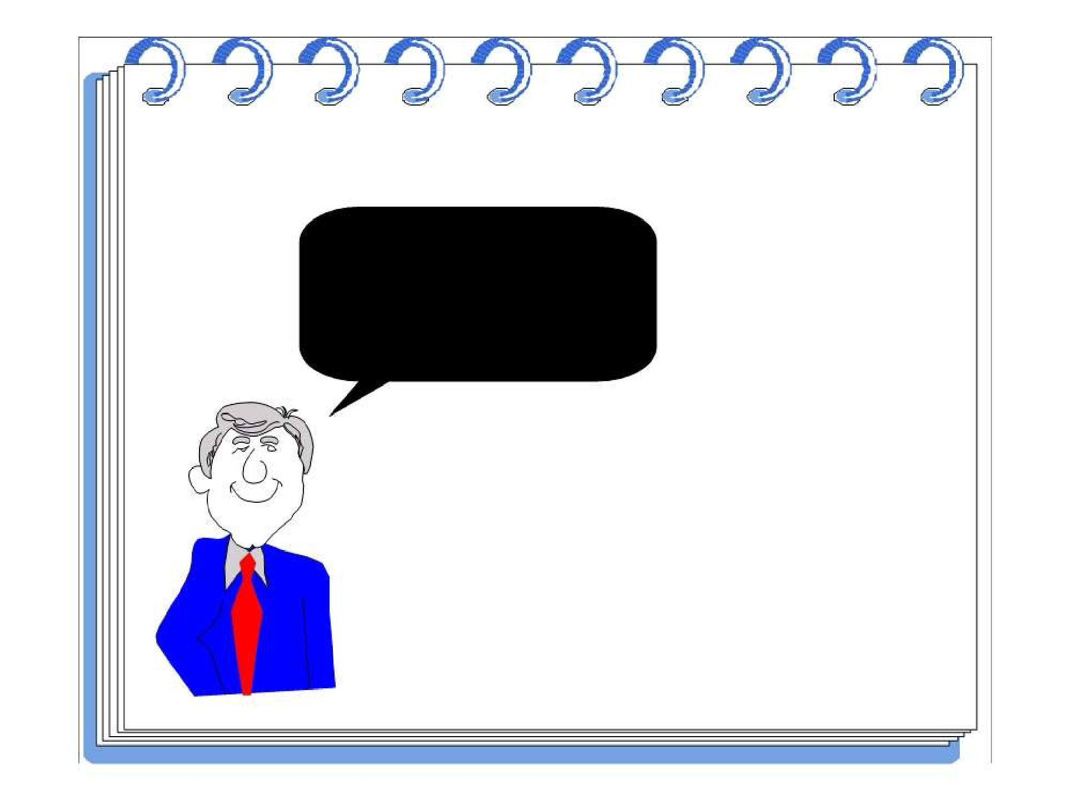
IT DOES THINGS (METHODS)
I know how to compute
my payroll.
Object-Oriented Systems Development
Bahrami
? Irwin/ McGraw-Hill

Slide 65
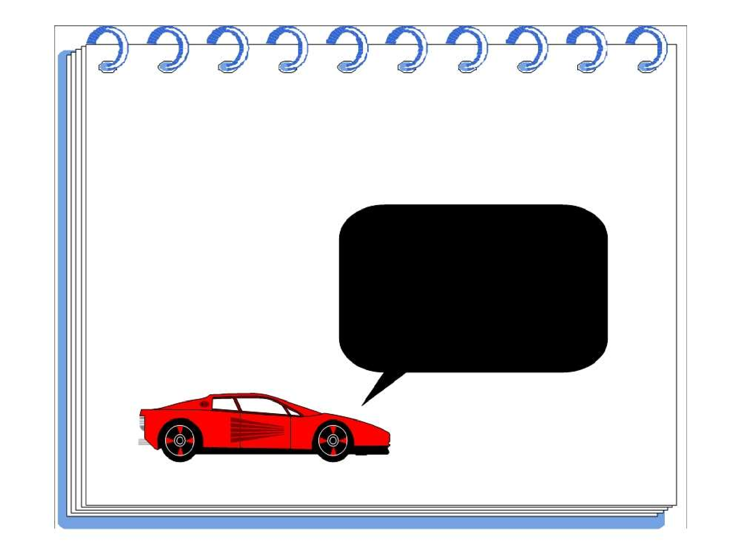
ATTRIBUTES
I am a Car.
I know my color, manufacturer, cost, owner and model.
Object-Oriented Systems Development
Bahrami
? Irwin/ McGraw-Hill

Slide 66
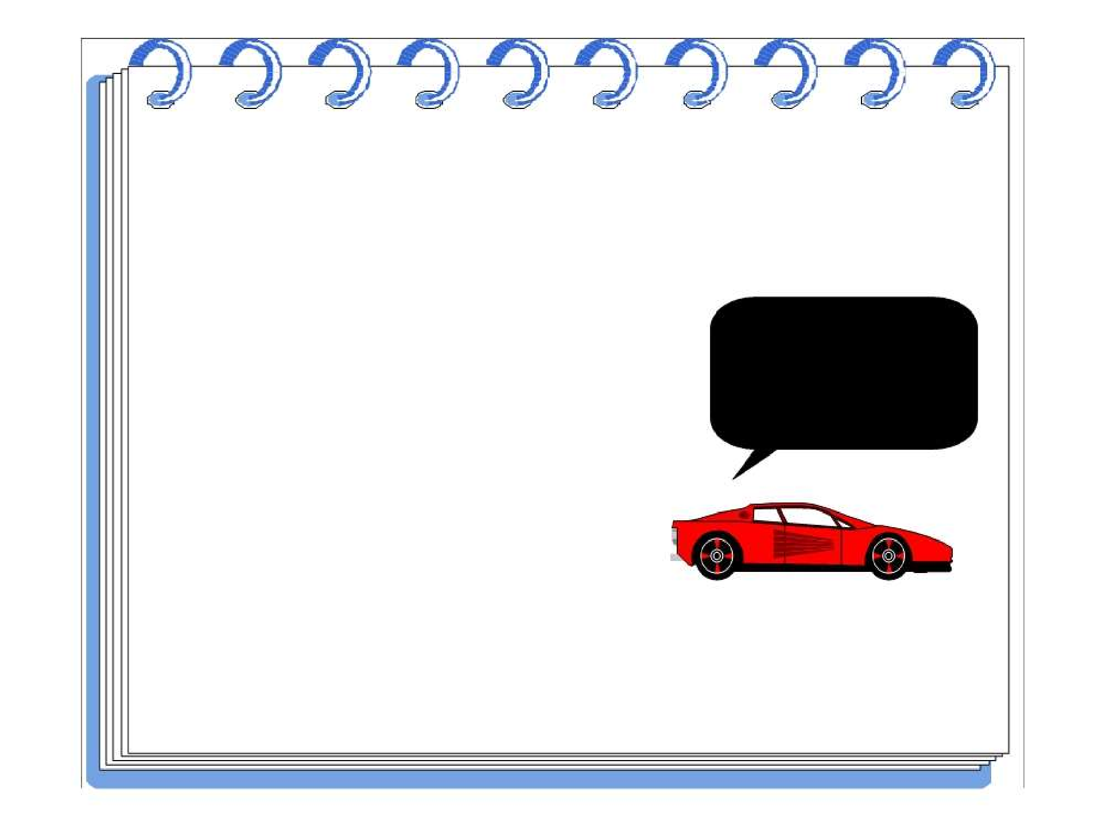
METHODS
I know how to stop.
Object-Oriented Systems Development
Bahrami
? Irwin/ McGraw-Hill

Slide 67
The Concept Of Object-Orientation
The fundamental idea behind object oriented approach is to combine both data and function into a single unit and these units are called objects.
OBJECT
IDENTITY
STATE
BEHAVIOUR

Slide 68
WHY OBJECT ORIENTATION
OO Methods enables to develop set of objects that work together →
software → similar to traditional techniques.
It adapts to
Changing requirements
Easier to maintain
More robust
Promote greater design
Code reuse

Slide 69
BENEFITS OF OBJECT ORIENTATION
Faster development,
Reusability,
Increased quality
modeling the real world and provides us with the stronger equivalence of the real world‘s entities (objects).
Raising the level of abstraction to the point where application can be implemented in the same terms as they are described.

Slide 70
Principles of Object-Oriented
Major Elements − The four major elements are −
Abstraction
Encapsulation
Modularity
Hierarchy

Slide 71
Principles of Object-Oriented
Minor Elements − The three minor elements are −
Typing
Concurrency
Persistence

Slide 72
Principles of Object-Oriented
1. Abstraction :- Grady Booch has defined abstraction as follows −
“An abstraction denotes the essential characteristics of an object that distinguish it from all other kinds of objects and thus provide crisply defined conceptual boundaries, relative to the perspective of the viewer.”
Example − When a class Student is designed, the attributes enrolment_number, name, course, and address are included while characteristics like pulse_rate and size_of_shoe are eliminated, since they are irrelevant in the perspective of the educational institution.

Slide 73
Principles of Object-Oriented
Types of Abstraction :-
Entity Abstraction- that represent the useful model of problem domain or solution domain.
Action abstraction:- an object that provides a generalized set of operation.
Virtual machine abstraction:- an object that groups operations that are all used by some superior level of control.
Coincidental abstraction:- an object that packages the set of operations that have no relation to each other.

Slide 74
Principles of Object-Oriented
Example Types of Abstraction :-
a student enroll in university
a teacher teaching
a course is a class offered by mu.
a course offering a specific offering for a course including days and week of time

Slide 75
Principles of Object-Oriented
2. Encapsulation:”- is the process of binding both attributes and methods together within a class. Through encapsulation, the internal details of a class can be hidden from outside. The class has methods that provide user interfaces by which the services provided by the class may be used.

Slide 76
Principles of Object-Oriented
3. Modularity is the property of a system that has been decomposed into a set of cohesive and loosely coupled modules.”
Modularity is intrinsically linked with encapsulation. Modularity can be visualized as a way of mapping encapsulated abstractions into real, physical modules having high cohesion within the modules and their inter–module interaction or coupling is low.

Slide 77
Principles of Object-Oriented
4. “Hierarchy:- is the ranking or ordering of abstraction”. Through hierarchy, a system can be made up of interrelated subsystems, which can have their own subsystems and so on until the smallest level components are reached. It uses the principle of “divide and conquer”. Hierarchy allows code reusability.
The two types of hierarchies in OOA are −
“IS–A” hierarchy − It defines the hierarchical relationship in inheritance, whereby from a super-class, a number of subclasses may be derived which may again have subclasses and so on. For example, if we derive a class Rose from a class Flower, we can say that a rose “is–a” flower.
“PART–OF” hierarchy − It defines the hierarchical relationship in aggregation by which a class may be composed of other classes. For example, a flower is composed of sepals, petals, stamens, and carpel. It can be said that a petal is a “part–of” flower.

Slide 78
Principles of Object-Oriented
1. Typing:-
According to the theories of abstract data type, a type is a characterization of a set of elements. In OOP, a class is visualized as a type having properties distinct from any other types. Typing is the enforcement of the notion that an object is an instance of a single class or type. It also enforces that objects of different types may not be generally interchanged; and can be interchanged only in a very restricted manner if absolutely required to do so.
The two types of typing are −
Strong Typing − Here, the operation on an object is checked at the time of compilation, as in the programming language Eiffel.
Weak Typing − Here, messages may be sent to any class. The operation is checked only at the time of execution, as in the programming language Smalltalk.

Slide 79
Principles of Object-Oriented
Concurrency
Concurrency in operating systems allows performing multiple tasks or processes simultaneously. When a single process exists in a system, it is said that there is a single thread of control. However, most systems have multiple threads, some active, some waiting for CPU, some suspended, and some terminated. Systems with multiple CPUs inherently permit concurrent threads of control; but systems running on a single CPU use appropriate algorithms to give equitable CPU time to the threads so as to enable concurrency.
In an object-oriented environment, there are active and inactive objects. The active objects have independent threads of control that can execute concurrently with threads of other objects. The active objects synchronize with one another as well as with purely sequential objects.

Slide 80
Principles of Object-Oriented
Persistence
An object occupies a memory space and exists for a particular period of time. In traditional programming, the lifespan of an object was typically the lifespan of the execution of the program that created it. In files or databases, the object lifespan is longer than the duration of the process creating the object. This property by which an object continues to exist even after its creator ceases to exist is known as persistence.

Slide 81
Object oriented development methods
A technique for system modeling
A technique to manage complexity in analysis, design and implementation.
A technique for analysis and design
A technique which provide integrated view of hardware and software.
Provide a methodology for system development.

Slide 82
Object oriented development methods
It is a new system development approach, encouraging and facilitating re-use of software components.
It employs international standard Unified Modeling Language (UML) from the Object Management Group (OMG).
Using this methodology, a system can be developed on a component basis, which enables the effective re-use of existing components, it facilitates the sharing of its other system components.
Object Oriented Methodology asks the analyst to determine what the objects of the system are?, What responsibilities and relationships an object has to do with the other objects? and How they behave over time?

Slide 83
Object oriented development methods
Examples:
Xerox
Space Telescope
Hubble Database
British Airways

Slide 84
Objectives of Object Oriented Methodologies
To encourage greater re-use.
To produce a more detailed specification of system constraints.
To have fewer problems with validation (Are we building the right product?).

Slide 85
Benefits of Object Oriented Methodologies
It represents the problem domain, because it is easier to produce and understand designs.
It allows changes more easily.
It provides nice structures for thinking, abstracting and leads to modular design.

Slide 86
Object oriented method types
1. Object Modeling Techniques (OMT)
2. Object Process Methodology (OPM)
3. Rational Unified Process (RUP)

Slide 87
1. Object Modeling Techniques (OMT)
It was one of the first object oriented methodologies and was introduced by Rumbaugh in 1991.
OMT uses three different models that are combined in a way that is analogous to the older structured methodologies.

Slide 88
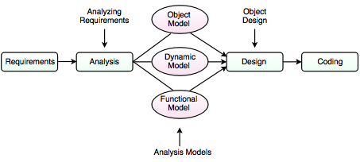
1. Object Modeling Techniques (OMT)

Slide 89
1. Object Modeling Techniques (OMT)
A. Analysis:- The main goal of the analysis is to build models of the world.
The requirements of the users, developers and managers provide the information needed to develop the initial problem statement.

Slide 90
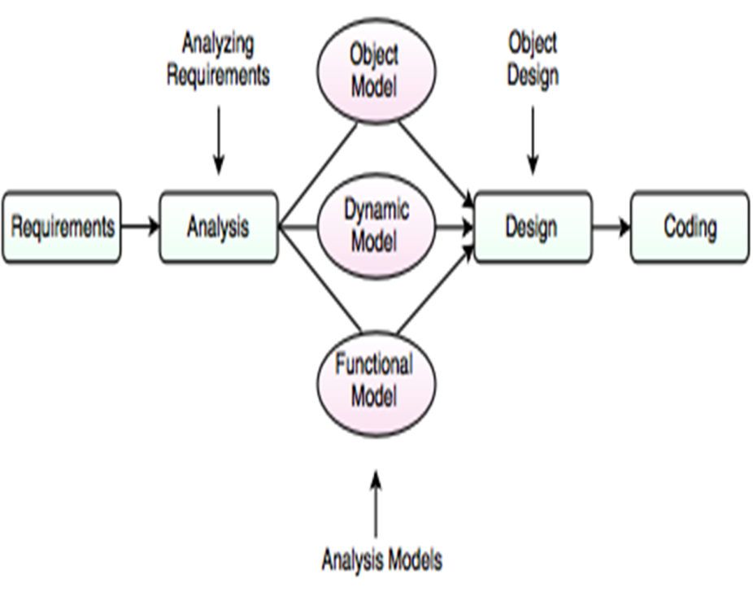
1. Object Modeling Techniques (OMT)
B. OMT Models
1. Object Model
2. Dynamic Model
3. Functional model

Slide 91
1. Object Modeling Techniques (OMT)
1. Object Model:- It depicts the object classes and their relationships as a class diagram, which represents the static structure of the system.
It observes all the objects as static and does not pay any attention to their dynamic nature.

Slide 92
1. Object Modeling Techniques (OMT)
2. Dynamic Model:- It captures the behavior of the system over time and the flow control and events in the Event-Trace Diagrams and State Transition Diagrams.
It portrays the changes occurring in the states of various objects with the events that might occur in the system.

Slide 93
1. Object Modeling Techniques (OMT)
3. Functional Model:- It describes the data transformations of the system.
It describes the flow of data and the changes that occur to the data throughout the system.

Slide 94
1. Object Modeling Techniques (OMT)
C. Design:- It specifies all of the details needed to describe how the system will be implemented.
In this phase, the details of the system analysis and system design are implemented.
The objects identified in the system design phase are designed.
D. Coding:-

Slide 95
2. Object Process Methodology (OPM)
It is also called as second generation methodology.
It was first introduced in 1995.
It has only one diagram that is the Object Process Diagram (OPD) which is used for modeling the structure, function and behavior of the system.
It has a strong emphasis on modeling but has a weaker emphasis on process.
It consists of three main processes:

Slide 96
2. Object Process Methodology (OPM)
I. Initiating: It determines high level requirements, the scope of the system and the resources that will be required. II. Developing: It involves the detailed analysis, design and implementation of the system. III. Deploying: It introduces the system to the user and subsequent maintenance of the system.

Slide 97
3. Rational Unified Process (RUP)
It was developed in Rational Corporation in 1998.
It consists of four phases which can be broken down into iterations. I. Inception II. Elaboration III. Construction IV. Transition
Each iteration consists of nine work areas called disciplines.
A discipline depends on the phase in which the iteration is taking place.
For each discipline, RUP defines a set of artefacts (work products), activities (work undertaken on the artefacts) and roles (the responsibilities of the members of the development team).

Slide 98
Rational unified process(rup)
Rational Unified Process (RUP) is a software development process for object-oriented models. It is also known as the Unified Process Model. It is created by Rational corporation and is designed and documented using UML (Unified Modeling Language). This process is included in IBM Rational Method Composer (RMC) product. IBM (International Business Machine Corporation) allows us to customize, design, and personalize the unified process.

Slide 99
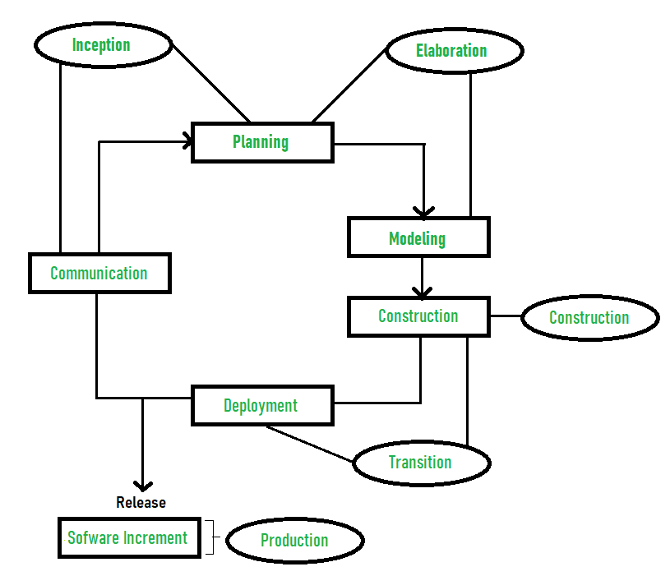
Rational unified process(rup)

Slide 100
Rational unified process(rup)
Testing:-
Unit testing- individual components are tested.
Acceptance testing- from customer side.
Beta testing- customer tested software with the software team.

Slide 101
Phases of rup
Inception –
Communication and planning are main.
Identifies Scope of the project using use-case model allowing managers to estimate costs and time required.
Customers requirements are identified and then it becomes easy to make a plan of the project.
Project plan, Project goal, risks, use-case model, Project description, are made.
Project is checked against the milestone criteria and if it couldn’t pass these criteria then project can be either cancelled or redesigned.
Elaboration –
Planning and modeling are main.
Detailed evaluation, development plan is carried out and diminish the risks.
Revise or redefine use-case model (approx. 80%), business case, risks.
Again, checked against milestone criteria and if it couldn’t pass these criteria then again project can be cancelled or redesigned.
Executable architecture baseline.

Slide 102
Phases of rup
Construction –
Project is developed and completed.
System or source code is created and then testing is done.
Coding takes place.
Transition –
Final project is released to public.
Transit the project from development into production.
Update project documentation.
Beta testing is conducted.
Defects are removed from project based on feedback from public.
Production –
Final phase of the model.
Project is maintained and updated accordingly.

Slide 103
Advantages of rup
It allows us to deal with changing requirements within the project’s development life cycle as per the client or customer needs, i.e. it welcomes change.
It provides proper documentation of the software product.
It helps to use the resources efficiently. Openly published, distributed and supported.
It improves process control and risk management.

Slide 104
Drawbacks of rup
It is a complex model to implement as it has multiple stages of the workflow.
It is challenging for organizations to implement which has, small team size or projects.
It should be highly result-oriented from individuals or teams.
It emphasizes the integration of modules throughout the software development process, so this creates trouble during the testing phase.

Slide 105
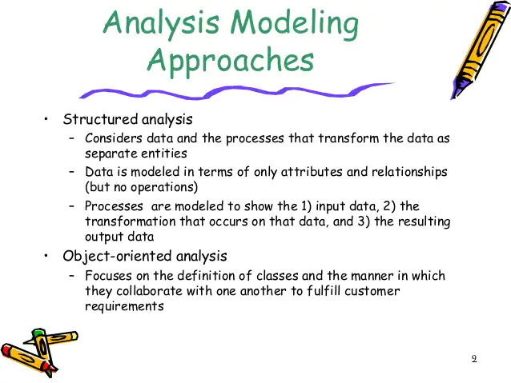

Slide 106
Object oriented approaches
In the object-oriented approach, the focus is on capturing the structure and behavior of information systems into small modules that combines both data and process. The main aim of Object Oriented Design (OOD) is to improve the quality and productivity of system analysis and design by making it more usable.
In analysis phase, OO models are used to fill the gap between problem and solution. It performs well in situation where systems are undergoing continuous design, adaption, and maintenance. It identifies the objects in problem domain, classifying them in terms of data and behavior.

Slide 107

UML- Overview,
UML (Unified Modeling Language) is a general-purpose, graphical modeling language in the field of Software Engineering. UML is used to specify, visualize, construct, and document the artifacts (major elements) of the software system. It was initially developed by Grady Booch, Ivar Jacobson, and James Rumbaugh in 1994-95 at Rational software, and its further development was carried out through 1996. In 1997, it got adopted as a standard by the Object Management Group.

Slide 108
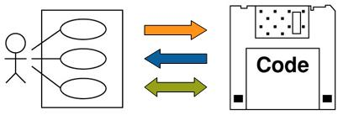
UML- Overview,
UML is neither a procedure nor a process; rather, it provides a "dictionary" of symbols - each of which has a specific meaning. It offers diagram types for object-oriented analysis, design and programming, thereby ensuring a seamless transition from requirements placed on a system to final implementation. Structure and system behavior are likewise shown, thereby offering clear reference points for solution optimization.

Slide 109
Goals of UML
Since it is a general-purpose modeling language, it can be utilized by all the modelers.
UML came into existence after the introduction of object-oriented concepts to systemize and consolidate the object-oriented development, due to the absence of standard methods at that time.
The UML diagrams are made for business users, developers, ordinary people, or anyone who is looking forward to understand the system, such that the system can be software or non-software.
Thus it can be concluded that the UML is a simple modeling approach that is used to model all the practical systems.

Slide 110
Characteristics of UML
It is a generalized modeling language.
It is distinct from other programming languages like C++, Python, etc.
It is interrelated to object-oriented analysis and design.
It is used to visualize the workflow of the system.
It is a pictorial language, used to generate powerful modeling artifacts.

Slide 111
UML is made up of −
Diagrams − It is a pictorial representations of process, system, or some part of it.
Notations − It consists of elements that work together in a diagram such as connectors, symbols, notes, etc.

Slide 112
Systems and Models in UML
System − A set of elements organized to achieve certain objectives form a system. Systems are often divided into subsystems and described by a set of models.
Model − Model is a simplified, complete, and consistent abstraction of a system, created for better understanding of the system.
View − A view is a projection of a system’s model from a specific perspective.

Slide 113
Conceptual Model of UML
The Conceptual Model of UML encompasses three major elements −
Basic building blocks
Rules
Common mechanisms

Slide 114
Basic Building Blocks
The three building blocks of UML are −
Things
Relationships
Diagrams

Slide 115
Basic Building Blocks
1. Things
There are four kinds of things in UML, namely −
Structural Things − These are the nouns of the UML models representing the static elements that may be either physical or conceptual. The structural things are class, interface, collaboration, use case, active class, components, and nodes.
Behavioral Things − These are the verbs of the UML models representing the dynamic behavior over time and space. The two types of behavioral things are interaction and state machine.
Grouping Things − They comprise the organizational parts of the UML models. There is only one kind of grouping thing, i.e., package.
Annotational Things − These are the explanations in the UML models representing the comments applied to describe elements.

Slide 116
Basic Building Blocks
The three building blocks of UML are −
Things
Relationships
Diagrams

Slide 117
Basic Building Blocks
2. Relationships
Relationships are the connection between things. The four types of relationships that can be represented in UML are −
Dependency − This is a semantic relationship between two things such that a change in one thing brings a change in the other. The former is the independent thing, while the latter is the dependent thing.
Association − This is a structural relationship that represents a group of links having common structure and common behavior.
Generalization − This represents a generalization/specialization relationship in which subclasses inherit structure and behavior from super-classes.
Realization − This is a semantic relationship between two or more classifiers such that one classifier lays down a contract that the other classifiers ensure to abide by.

Slide 118
Basic Building Blocks
The three building blocks of UML are −
Things
Relationships
Diagrams

Slide 119
Basic Building Blocks
3. Diagrams
A diagram is a graphical representation of a system. It comprises of a group of elements generally in the form of a graph. UML includes nine diagrams in all, namely −
Class Diagram
Object Diagram
Use Case Diagram
Sequence Diagram
Collaboration Diagram
State Chart Diagram
Activity Diagram
Component Diagram
Deployment Diagram

Slide 120
Conceptual Model of UML
The Conceptual Model of UML encompasses three major elements −
Basic building blocks
Rules
Common mechanisms

Slide 121
rules
UML has a number of rules so that the models are semantically self-consistent and related to other models in the system harmoniously. UML has semantic rules for the following −
Names
Scope
Visibility
Integrity
Execution

Slide 122
Conceptual Model of UML
The Conceptual Model of UML encompasses three major elements −
Basic building blocks
Rules
Common mechanisms

Slide 123
Common mechanisms
UML has four common mechanisms −
Specifications:- behind each graphical notation, there is a textual statement denoting the syntax and semantics. These are the specifications. The specifications provide a semantic backplane that contains all the parts of a system and the relationship among the different paths.
Adornments:- Each element in UML has a unique graphical notation. Besides, there are notations to represent the important aspects of an element like name, scope, visibility, etc.

Slide 124
Common mechanisms
3. Common Divisions:- Object-oriented systems can be divided in many ways. The two common ways of division are −
Division of classes and objects −
Division of Interface and Implementation .
4. Extensibility Mechanisms:-
Stereotypes − It extends the vocabulary of the UML, through which new building blocks can be created out of existing ones.
Tagged Values − It extends the properties of UML building blocks.
Constraints − It extends the semantics of UML building blocks.

Slide 125
Three ways to apply UML:
UML as sketch: Informal and incomplete diagrams created to explore difficult parts of the problem.
UML as blueprint: Detailed design diagram used for better understanding of code.
UML as programming language: Complete executable specification of a software system in UML.

Slide 126
Three perspectives to apply UML:
Conceptual perspective: Diagrams describe the things of real world.
Specification perspective: Diagrams describe software abstractions or components with specifications and interfaces.
Implementation perspective: Diagrams describe software implementation in a particular technology

Slide 127
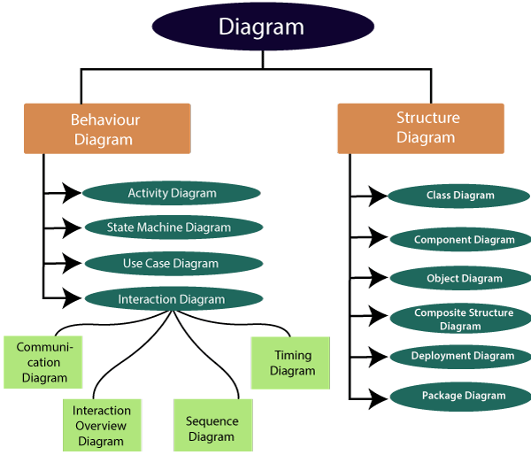

Slide 128
Use case diagram
Use Case Diagram captures the system’s functionality and requirements by using actors and use cases. Use Cases model the services, tasks, function that a system needs to perform. Use cases represent high-level functionalities and how a user will handle the system. Use-cases are the core concepts of Unified Modelling language modeling.

Slide 129
Class diagram
The class diagram depicts a static view of an application. It represents the types of objects residing in the system and the relationships between them. A class consists of its objects, and also it may inherit from other classes. A class diagram is used to visualize, describe, document various different aspects of the system, and also construct executable software code.
It shows the attributes, classes, functions, and relationships to give an overview of the software system. It constitutes class names, attributes, and functions in a separate compartment that helps in software development.

Slide 130
Activity diagram
the activity diagram is used visually represent a series of actions/ flow of control within the system.
It models the concurrent and sequential activities.
An activity graph assumes that computations proceeds without external event based interruptions.
Activity is a particular operation of the system. Activity diagrams are not only used for visualizing the dynamic nature of a system, but they are also used to construct the executable system by using forward and reverse engineering techniques.

Slide 131
Swim lane diagram
A swimlane or swimlane diagram is a type of activity diagram that shows who is responsible for each part of a process. The name references the lanes you'd see in a swimming pool, with each lane acting as a space for a business role or department. Swimlanes are also called Functional Bands, Multi-Column Charts, or Rummler-Brache diagrams
To communicate and highlight which process steps or sub-processes are assigned to a particular actor within an organization, thus helping everyone involved know who is doing what.

Slide 133
THANK YOU

